Slide 1
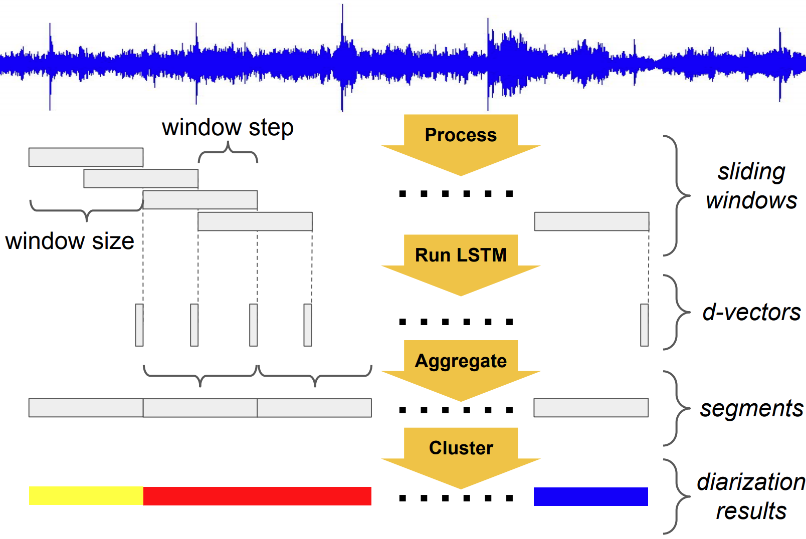
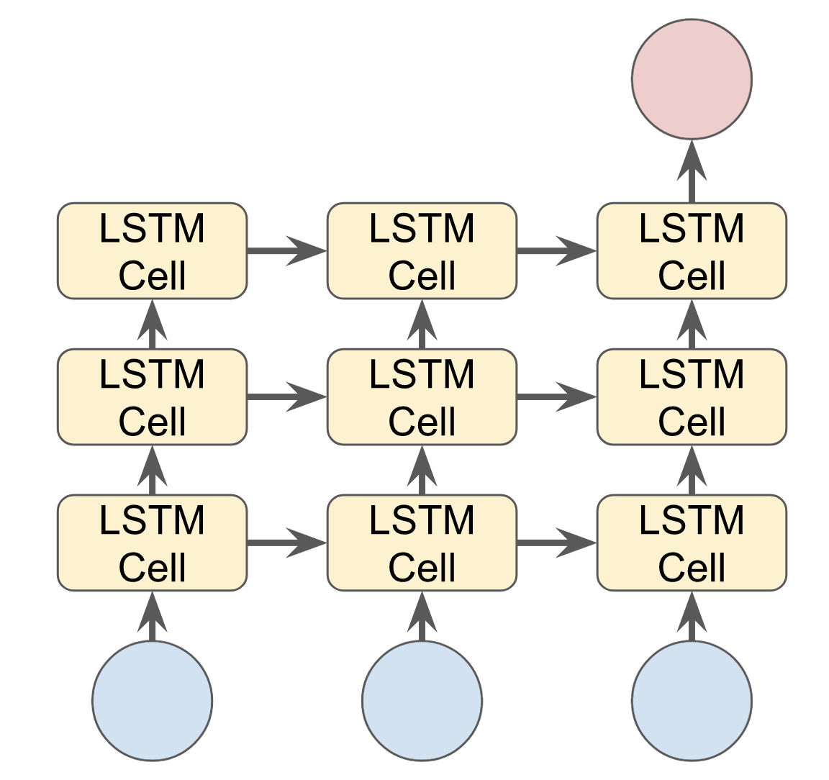
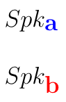
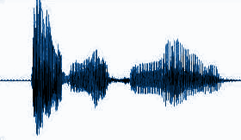
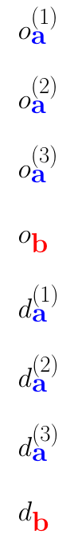
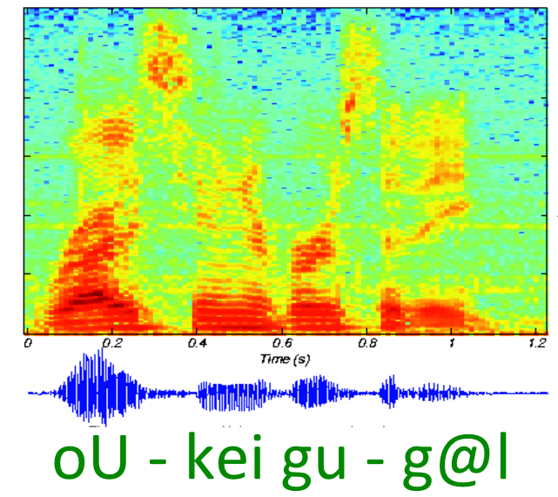
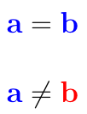
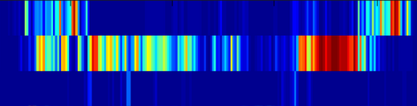
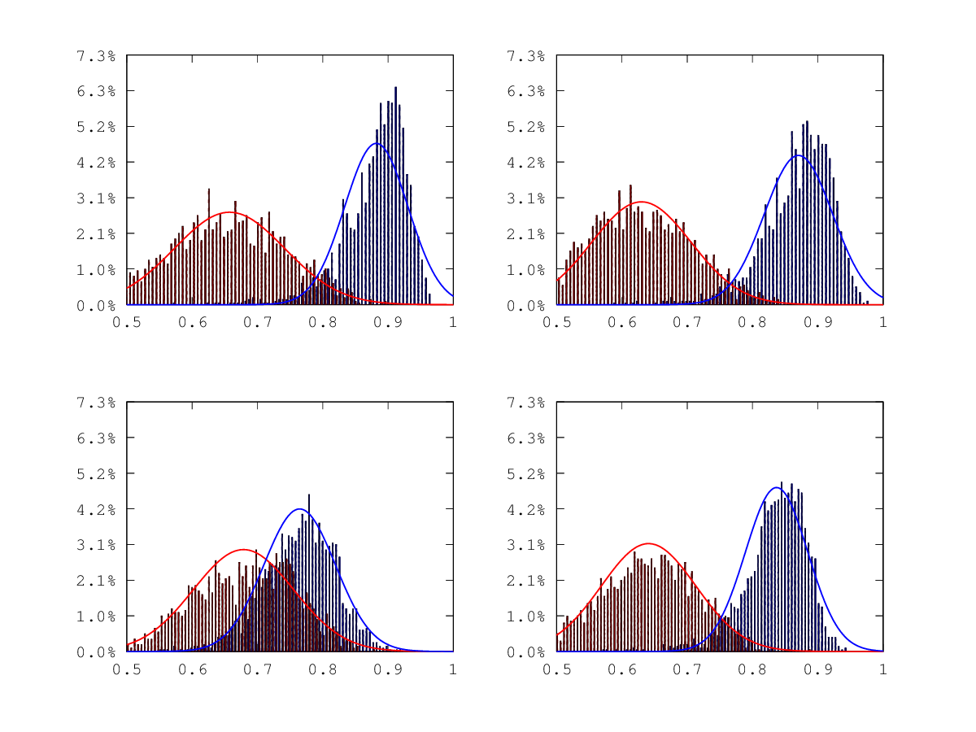
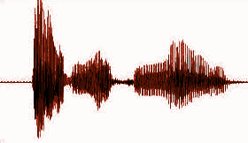
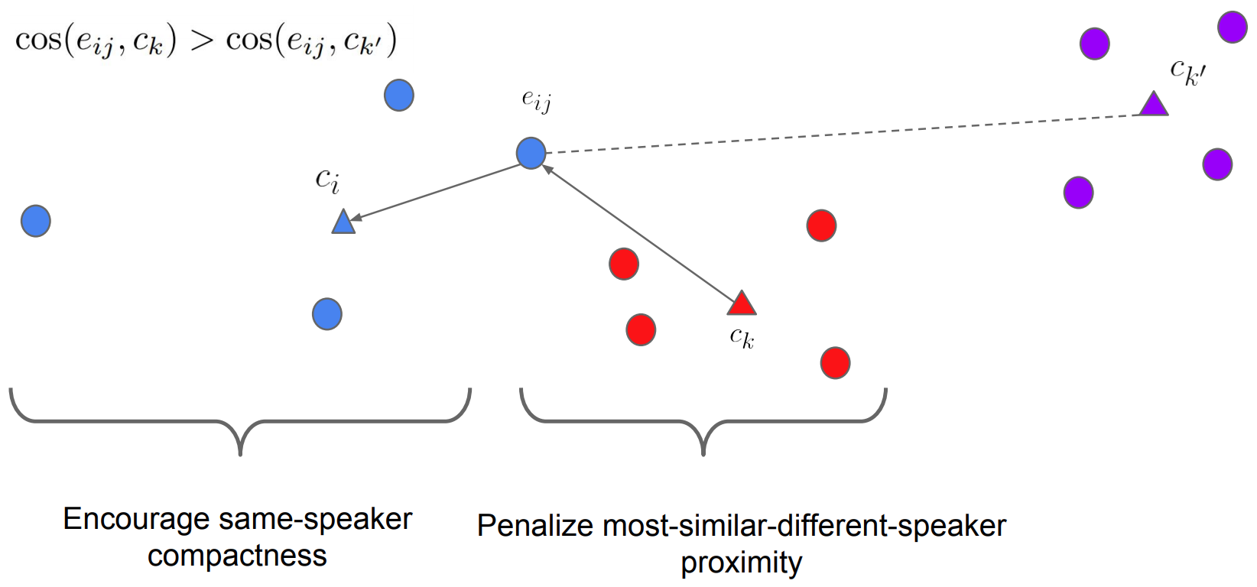
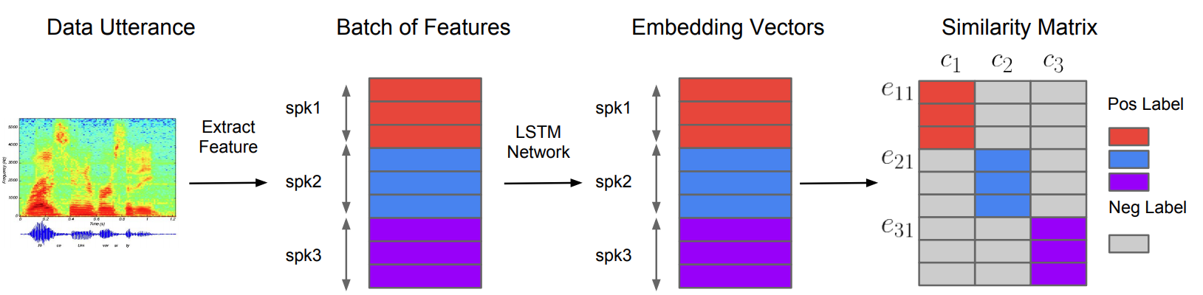
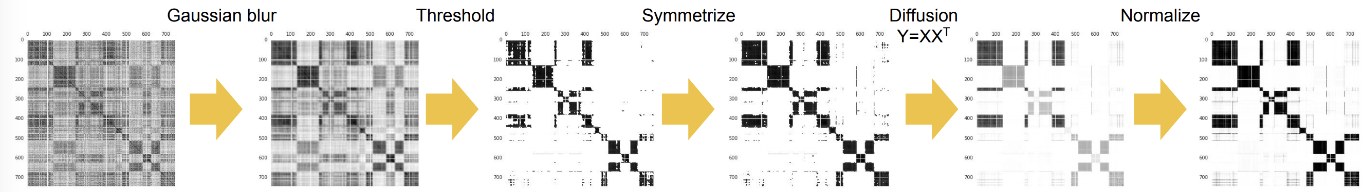
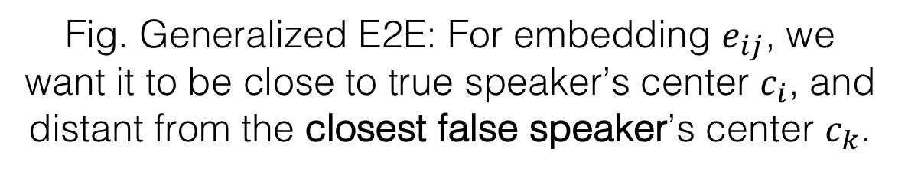
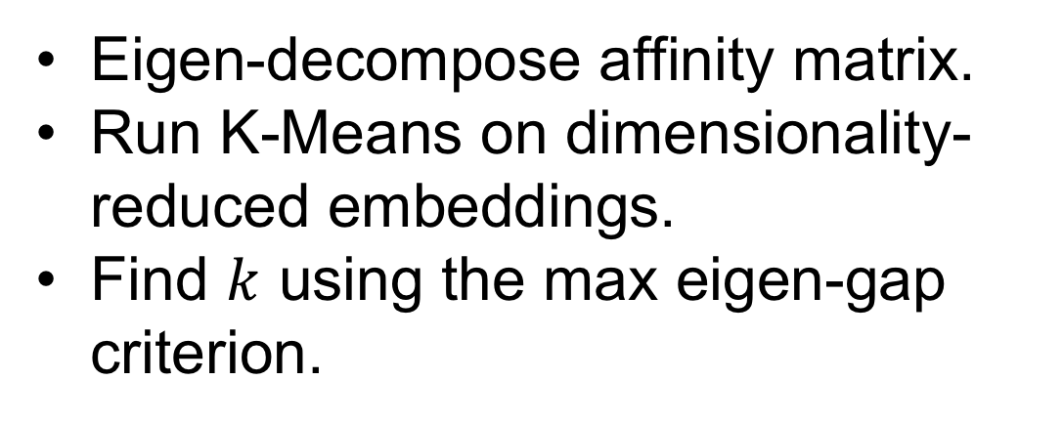
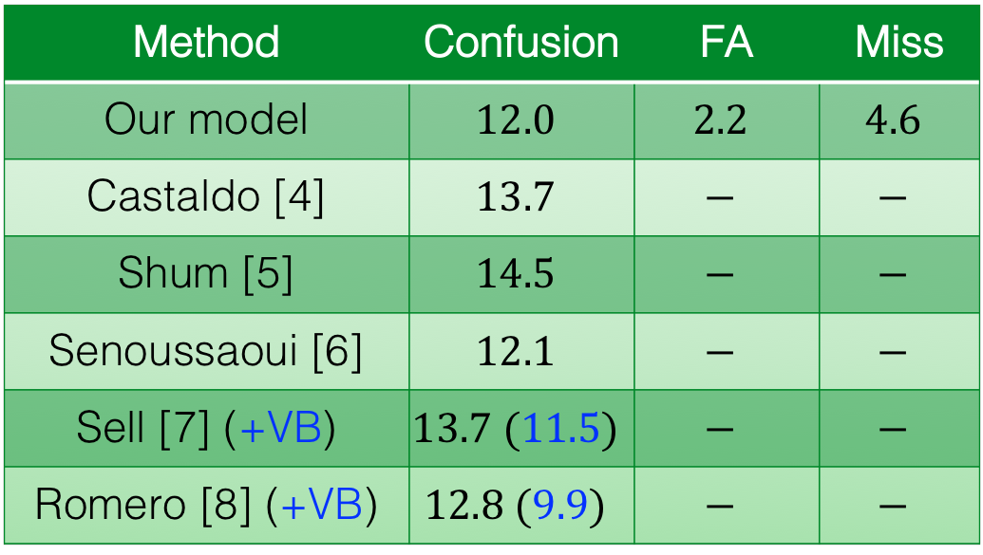
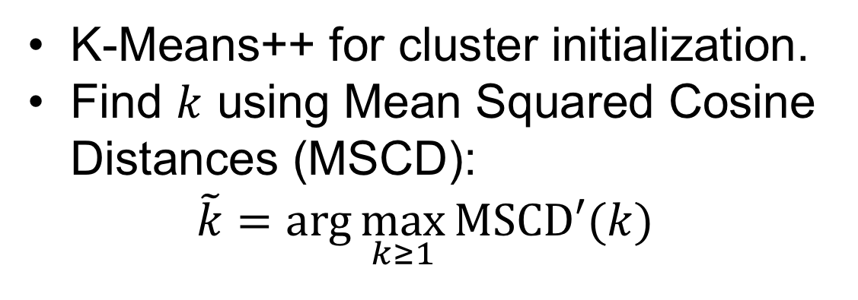
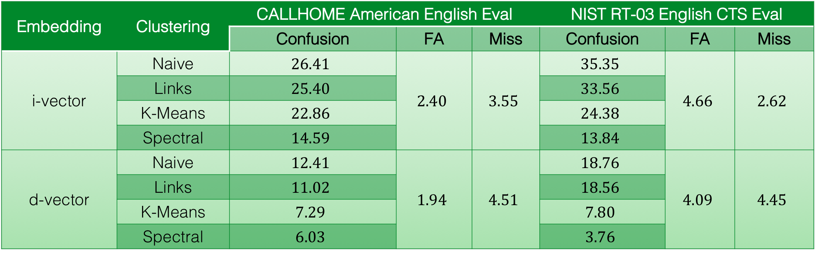
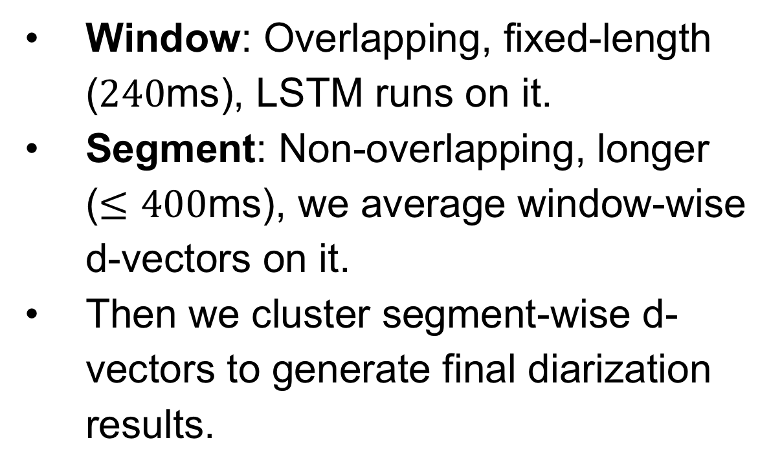
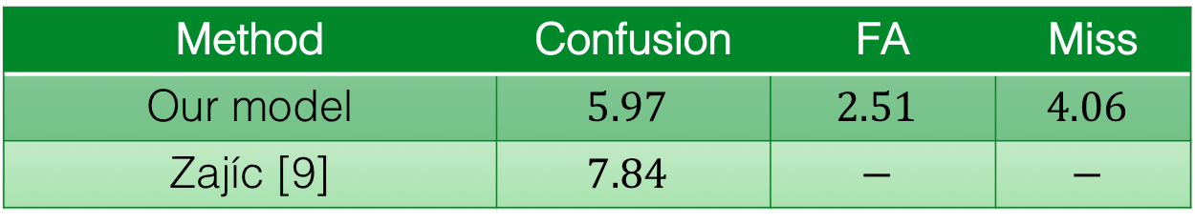
Overview
Sliding Window Inference
Experiment Results
We use an LSTM-based speaker verification model [1] for speaker diarization.
Model is trained on anonymized voice searches, and evaluated on out-of-domain data (CALLHOME & NIST RT-03 etc.).
With a modified version of spectral clustering, we achieve state-of-the-art Diarization Error Rate (DER).
Window: Overlapping, fixed-length ($240$ms), LSTM runs on it.
Segment: Non-overlapping, longer ($≤400$ms), we average window-wise d-vectors on it.
Then we cluster segment-wise d-vectors to generate final diarization results.
Training Set
Anonymized voice searches
36M utterances from 18K speakers
Dev Set
Separated from Eval Set
Eval Set
Standard public datasets: NIST RT-03, NIST SRE 2000, etc.
Train LSTM network
Tune VAD, window size/step, refinement parameters, etc.
Report DER
Speaker 1
1st pass ASR
I would like to sort of buy needle interrupt
Fig. Our network is completely trained on out-of-domain data: voice search vs. telephone speech.
Diarization
Speaker1
Speaker2
Embedding | Clustering | CALLHOME American English Eval |  |  | NIST RT-03 English CTS Eval
 |  | Confusion | FA | Miss | Confusion | FA | Miss
i-vector | Naive | $$26.41$$ | $$2.40$$ | $$3.55$$ | $$35.35$$ | $$4.66$$ | $$2.62$$
 | Links | $$25.40$$ |  |  | $$33.56$$
 | K-Means | $$22.86$$ |  |  | $$24.38$$
 | Spectral | $$14.59$$ |  |  | $$13.84$$
d-vector | Naive | $$12.41$$ | $$1.94$$ | $$4.51$$ | $$18.76$$ | $$4.09$$ | $$4.45$$
 | Links | $$11.02$$ |  |  | $$18.56$$
 | K-Means | $$7.29$$ |  |  | $$7.80$$
 | Spectral | $$6.03$$ |  |  | $$3.76$$
I would like to sort of buy needle interrupt
Speaker 2
2nd pass ASR
on homogeneous
segments
Discouraged by language model in 1st pass
Clustering Algorithms
I would like to … Sorry but I need to interrupt
Fig. Speaker diarization solves the problem of “who spoke when”.
Fig. Example application: Improve ASR with diarization results.
Naïve online
Links online [3]
D-Vector Embedding: TE2E to GE2E
Thresholding the cosine similarities to centroids.
Anisotropic, probabilistic, and generative cluster modeling.
LSTM
Diff spk
Same spk
LSTM
Average
Table. DER (%) on English-only datasets for different embeddings and clustering algorithms.
...
LSTM
Cosine Similarity
K-Means offline
Spectral offline (Winner!)
Method | Confusion | FA | Miss
Our model | $$12.0$$ | $$2.2$$ | $$4.6$$
Castaldo [4] | $$13.7$$ | $$−$$ | $$−$$
Shum [5] | $$14.5$$ | $$−$$ | $$−$$
Senoussaoui [6] | $$12.1$$ | $$−$$ | $$−$$
Sell [7] (+VB) | $$13.7 (11.5)$$ | $$−$$ | $$−$$
Romero [8] (+VB) | $$12.8 (9.9)$$ | $$−$$ | $$−$$
Method | Confusion | FA | Miss
Our model | $$5.97$$ | $$2.51$$ | $$4.06$$
Zajíc [9] | $$7.84$$ | $$−$$ | $$−$$
LSTM
K-Means++ for cluster initialization.
Find $k$ using Mean Squared Cosine Distances (MSCD):
$$\tilde{k}=\arg{\max_{k≥1}{MSCD′(k)}}$$
Eigen-decompose affinity matrix.
Run K-Means on dimensionality-reduced embeddings.
Find $k$ using the max eigen-gap criterion.
Fig. We use multi-layer LSTM network as audio feature extractor.
Fig. Tuple E2E loss: Speaker verification as a binary classification problem.
Table (Left). DER (%) on NIST SRE 2000 CALLHOME. VB for Variational Bayesian resegmentation.
Table (Up). DER (%) on CALLHOME American English 2-speaker subset (CH-109).
Tuple E2E [2]: Simulate enroll-verify runtime logic during training. However, tuples are randomly selected, and most tuples are easy – inefficient.
Generalized E2E loss [1]: For each speaker, focus on its most offensive imposter in the batch.
Fig. We experimented with four clustering algorithms. Two of them are online (Naïve and Links), and the other two are offline (K-Means and Spectral).
References
Extract batch of audio embeddings
Compute similarity matrix
Affinity matrix refinement: The key to the success of spectral clustering.
Gaussian blur: Smooth the data, and reduce the effect of outliers.
Row-wise thresholding: Zero-out affinities between different speakers.
Symmetrization: Restore matrix symmetry.
Diffusion: Sharpen affinity section boundaries of distinct speakers.
Row-wise max normalization: Avoid undesirable scale effects.
[1] Li Wan, et al., “Generalized end-to-end loss for speaker verification,” arXiv:1710.10467, 2017.
[2] Georg Heigold, et al., “End-to-end text-dependent speaker verification,” ICASSP 2016.
[3] Philip Andrew Mansfield, et al., “Links: A high dimensional online clustering method,” arXiv:1801.10123, 2018.
[4] Fabio Castaldo, et al., “Stream-based speaker segmentation using speaker factors and eigenvoices,” ICASSP 2008.
[5] Stephen H Shum, et al., “Unsupervised methods for speaker diarization: An integrated and iterative approach,” TASLP 2013.
[6] Mohammed Senoussaoui, et al., “A study of the cosine distance-based mean shift for telephone speech diarization,” TASLP 2014.
[7] Gregory Sell, et al., “Diarization resegmentation in the factor analysis subspace,” ICASSP 2015.
[8] Daniel Garcia-Romero, et al., “Speaker diarization using deep neural network embeddings,” ICASSP 2017.
[9] Zbyněk Zajíc, et al., “Speaker diarization using convolutional neural network for statistics accumulation refinement,” INTERSPEECH 2017.
Fig. Generalized E2E: For embedding $e_{ij}$, we want it to be close to true speaker’s center $c_{i}$, and distant from the closest false speaker’s center $c_{k}$.
Fig. For each training batch, we build a matrix for utterance-to-speaker similarities, which greatly accelerates the loss computation.
Fig. We apply a sequence of refinement operations on the affinity matrix.

